Slide 1

Holiday Insights Dashboard
Data Analytics Report: Using Python, SQL, and Dashboard Visualization to Uncover Booking Trends

Slide 2




Project Overview
Objective
Tools Used
Analyze holiday booking data to identify revenue patterns, customer behaviors, and seasonal demand.
Python for data processing, MySQL for analysis, Power BI/Streamlit for visualization.
Goal
Transform raw booking data into actionable business insights that drive growth.

Slide 3
Data & Methodology
Data Source
01
02
holiday_bookings_full dataset from customer_booking database
Python Data Cleaning
SQL Analysis
ETL processes and data preparation
Data aggregation and metric calculation
Key Fields
Booking season & dates
03
Accommodation type
Dashboard Visualization
Customer demographics
Total price & revenue
Insights presentation and reporting
Length of stay
Occupancy metrics

Slide 4
Key Performance Indicators
10,498
£10.4M
6
£367
Total Bookings
Total Revenue
Avg. Stay (Days)
Revenue per Guest
Strong customer engagement across all seasons
Healthy revenue generation from bookings
Solid customer retention per visit
Strong spending patterns per customer
Insight: Healthy engagement with solid customer spending patterns indicates a strong market position.

Slide 5
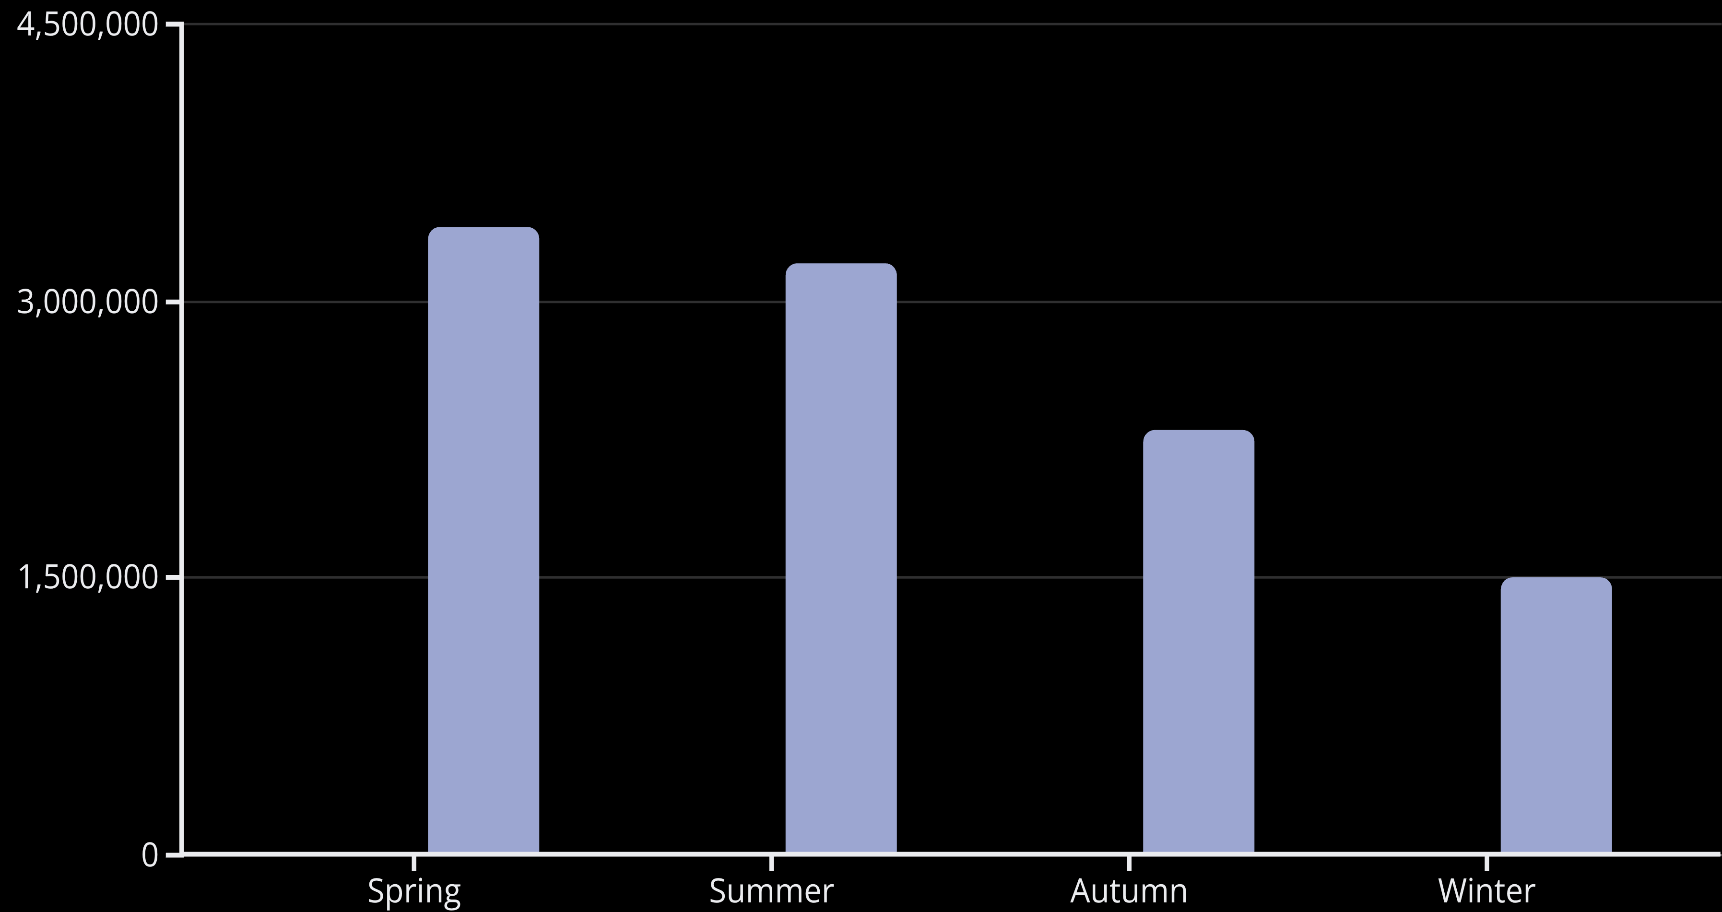

Seasonal Demand Patterns
Bookings
Revenue
Key Insight: Demand peaks in Spring and Summer with warmer months driving revenue. Winter shows lowest performance.
Action: Introduce off-season promotions and special winter packages to boost low-season performance.

Slide 6



Customer Segmentation Analysis
68%
29%
3%
Family Travelers
Couples
Solo Travelers
Core customer segment driving majority of bookings
Secondary market with strong revenue potential
Niche segment with growth opportunities
Takeaway: Focus marketing efforts on family-oriented promotions and develop loyalty programs targeting the core family segment.

Slide 7

Accommodation Performance
Top Revenue Earners per Night
Average Length of Stay
Lodges
80%
Hot Tub Lodges
Luxury Hot Tub Lodges
Touring Pitches
Pods
~8 days average
Wooden Lodges
60%
Insight: Premium lodges generate highest revenue while touring guests stay longest (~8 days).
Lodges
~6 days average
58%
Hot Tub Pods
~5.8 days average

Slide 8
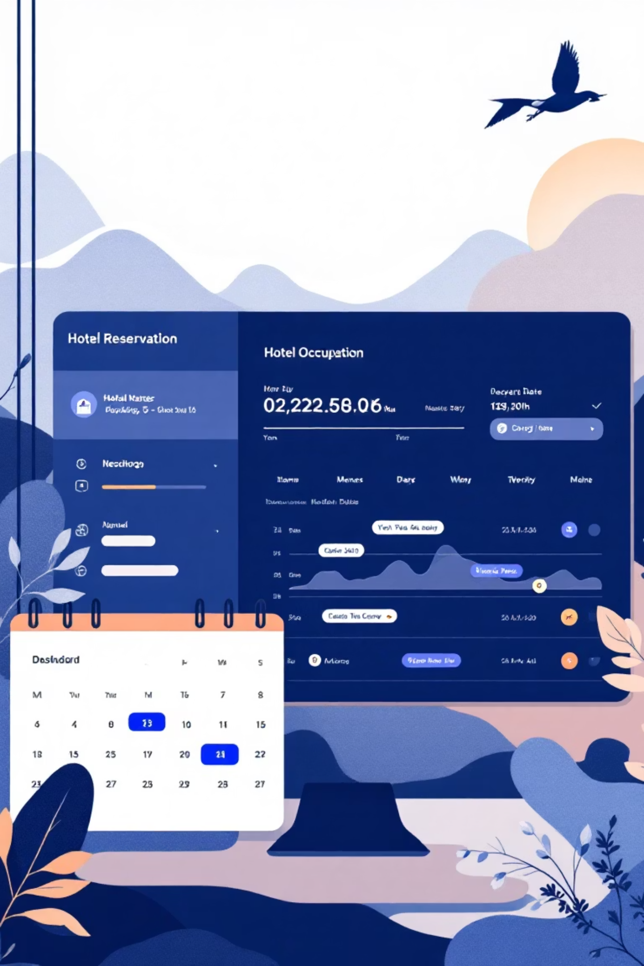
Booking Behavior & Occupancy
1
2
Lead Time Patterns
Occupancy Insights
Most bookings made within short to medium timeframes, indicating spontaneous travel decisions.
High average occupancy weight in Lodges and Cabins shows strong utilization rates.
3
Strategic Actions
Offer early booking discounts to capture planners and optimize pricing for last-minute guests.

Slide 9

Emerging Opportunities
Pet-Friendly Market Growth
Top 10 Accommodations
Moderate volume of pet-inclusive bookings with good average revenue from pet owners indicates growing market opportunity.
Lodges and Hot Tub Lodges lead booking volume
Pods and Cabins perform strongly for budget-conscious travelers
Recommendation: Promote pet-friendly accommodations prominently and expand pet-inclusive amenities.
Consistent demand across premium and standard options
Action: Expand capacity for high-demand units to capture additional revenue.

Slide 10
Strategic Recommendations
Off-Season Strategy
Customer Loyalty
Launch seasonal offers and winter packages to boost low-season bookings.
Create family-focused loyalty programs targeting the dominant 68% segment.
Premium Expansion
Pet-Friendly Growth
Add amenities to high-performing Lodges to maximize revenue per unit.
Invest in pet-friendly upgrades to capture emerging market demand.
Key Takeaway: Spring and Summer drive peak revenue, families are the core segment, and Lodges generate top earnings. Data-driven decisions enhance customer satisfaction, optimize pricing, and sustain long-term growth.
Analysis powered by Python, MySQL, and Power BI

